Slide 1
“Smart agriculture system based on IoT”

Slide 2
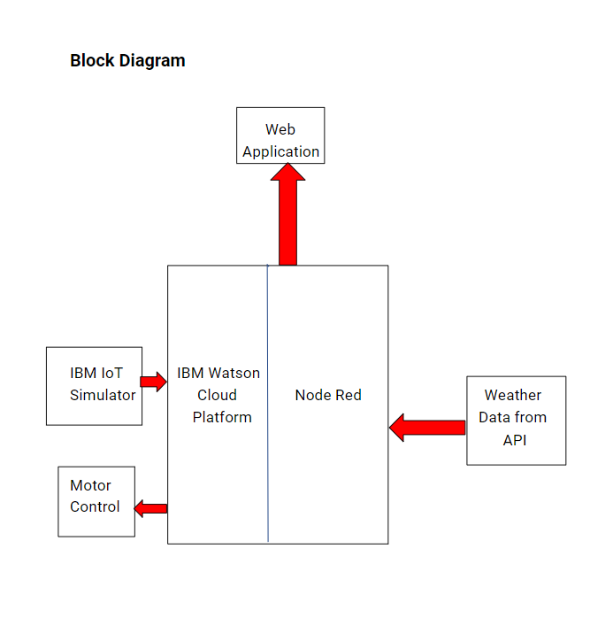

Slide 3
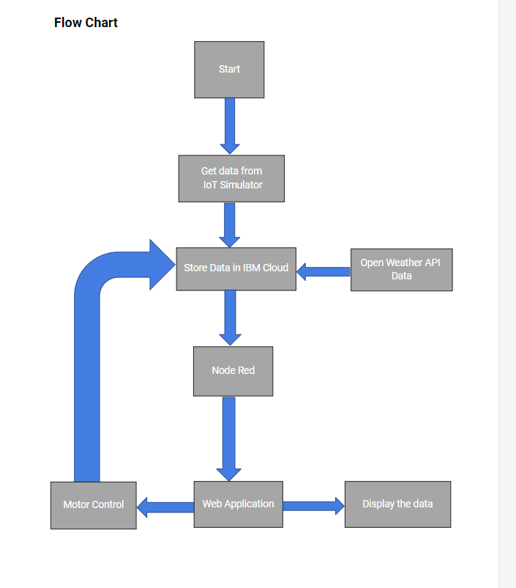

Slide 4
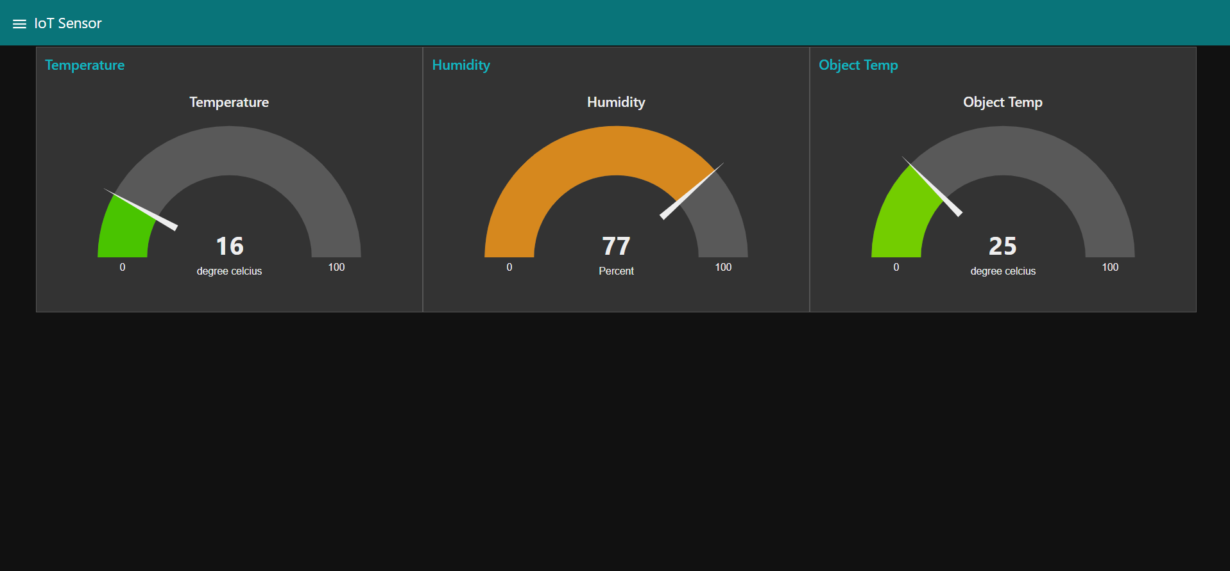
User Interface for Watson IoT Sensor

Slide 5
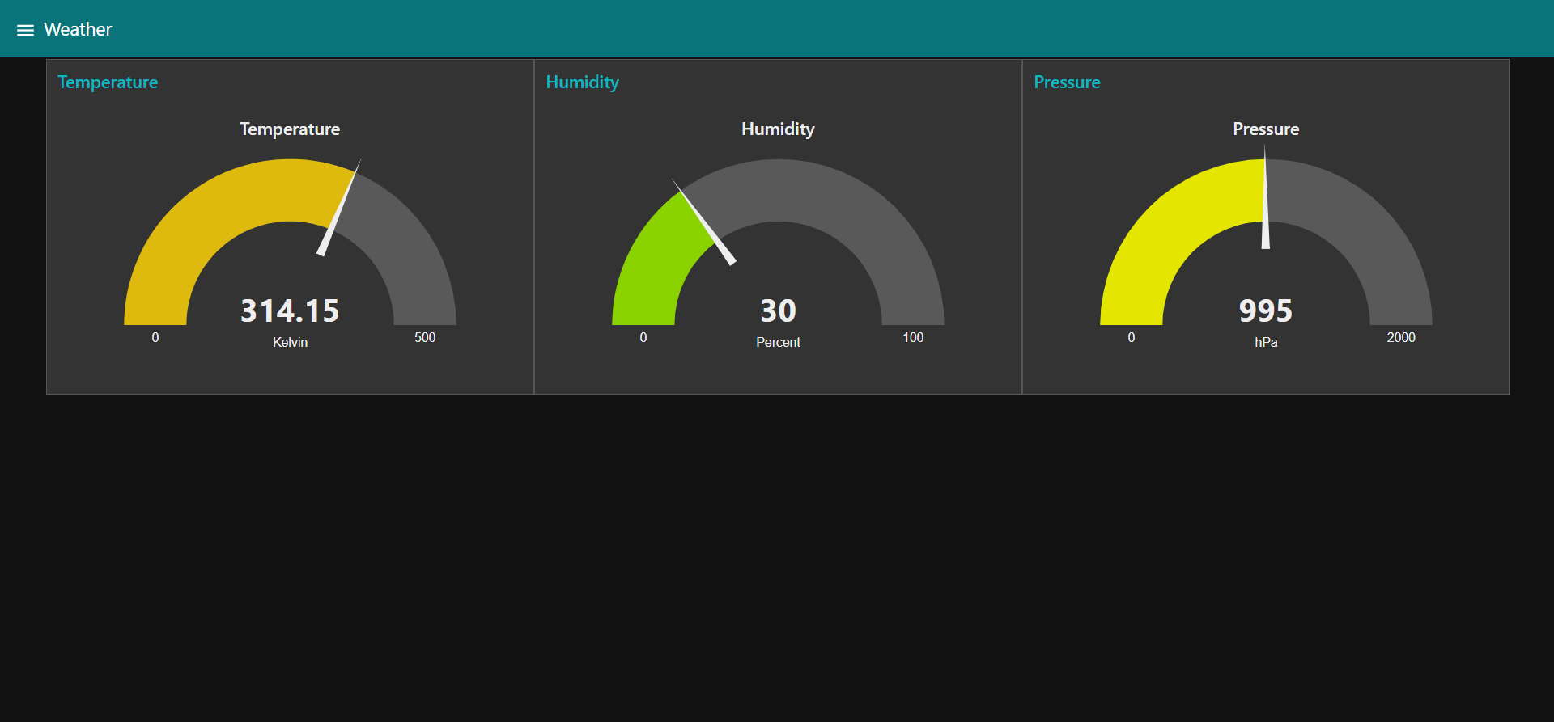
User Interface showing weather conditions of Jammu, J&K

Slide 6
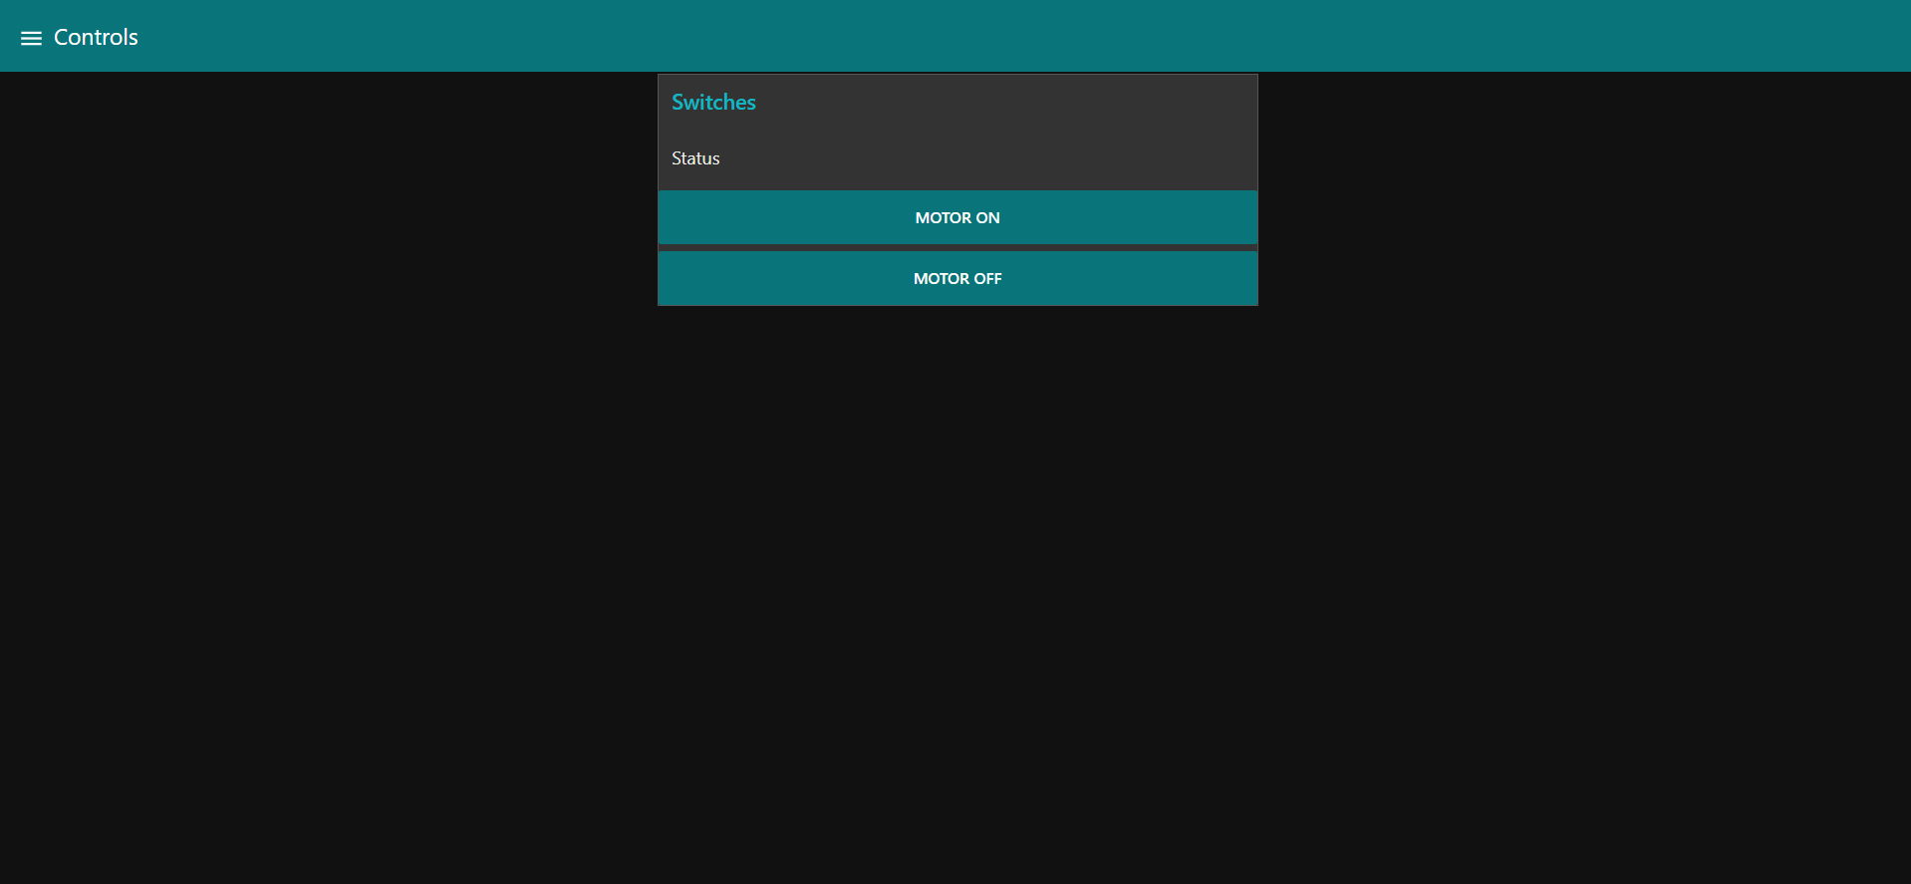
User Interface showing buttons for Motor

